Slide 1
A fast ultrasonic simulation TOOL BASED ON MASSIVELY PARALLEL IMPLEMENTATIONs
Jason LAMBERT¹, Gilles ROUGERON¹ , Lionel LACASSAGNE², and Sylvain CHATILLON¹.
¹CEA, LIST, F-91191 Gif-sur-Yvette, France
jason.lambert@cea.fr
²LRI, Université Paris-Sud, F-91405 Orsay cedex, France

Slide 2
sommaire
Context and objectives
Description of the UT simulation tools
Beam computation
Defect diffraction
Algorithm of a simulation
Description of CPU-multicore and GPU implementations
CPU and GPU specificities
Model validation with CIVA 10.1
Performances results

Slide 3
Context and objectives
Objectives : fast UT inspection simulation
Inspection designing tools (probe especially phased array, scanning, …)
POD curves computation, Data Base computation, inversion procedure
Means : exploitation of CPU-multicores and GPU capabilities
Intensively parallel computation (beam propagation and diffraction with defect)
New model based on analytical solution (beam propagation)
Use of high performances signal processing libraries (Intel MKL/NVidia CUFFT)
Limitations : canonical configurations
Simple geometries described by planar surfaces (planar, 2D CAD)
Homogeneous and isotropic materials
Planar defects (Kirchhoff approximation)
Half-skip

Slide 4
UT beam simulation using the paraxial ray tracing method
Optimization for isotropic and homogeneous planar component
Superposition of elementary contributions over the probe
1 - Analytical expression for ray paths computation
(direct and after backwall reflection with mode conversion)
Source point
Observation point
h(M,t)
Computation of the impulse response
Regular Probe discretization
Ray path optimization (no ray tracing)
2 - Analytical expression of the amplitude of the contribution (no matrix computation)
t
Divergence factor
Reflection and refraction coefficients
Extraction of beam characteristics for echo simulation
Amplitude and time of flight
Direction of propagation and polarization

Slide 5
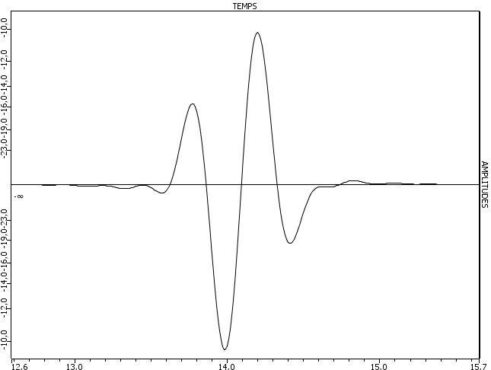
principle of UT Diffraction simulation
Generic formulation : Transmission Beam / Flaw scattering / Reception beam (by Auld’s reciprocity ) over the flaw discretization
« Received » Beam
Incident beam
Amplitude : q_{R}(M)
Time of Flight : T_{R}
Observation direction
Observation polarization
Amplitude : q_{E}(M)
Time of flight : T_{E}
Incident direction
incident polarization
M
Synthesis of the received signal using Auld’s reciprocity principle
S_{ER}(t)=
Σ
q_{R}(M)q_{E}(M){K(M,t).e^{iφ}_{Ε}.e^{iφ}_{R}}.S(t-T_{E}-T_{R})}
M
Flaw meshing
K(M,t)
Kirchhoff diffraction coefficient, valid near specular reflection

Slide 6
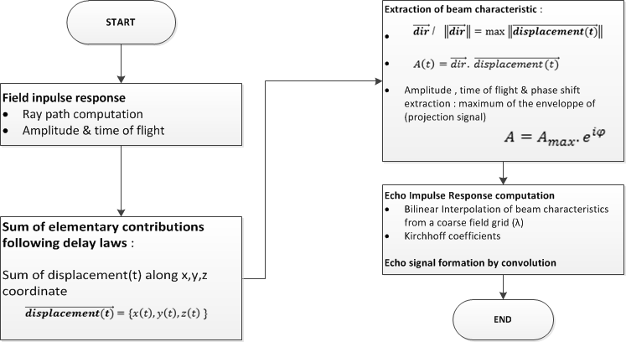
Algorithm Of a DIFFRACTION SIMULATION

Slide 7
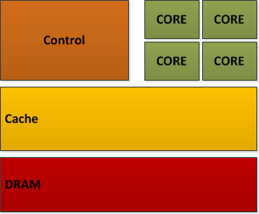
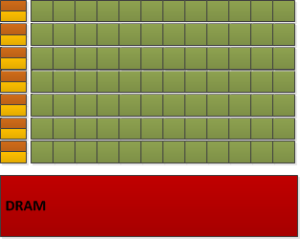
Overview of CPU and GPU Platform
Multicore CPU
Small number of cores (10s)
Cores can work on different tasks (task parallelism)
Core can handle complex task
GPU
Numerous smaller cores (100s)
A same task executed on multiple data by multiple cores ( data parallelism )
Memory access shared across cores
Coprocessor : separate memory from host CPU
Notes:
Presenter brievement les differences, l’auditoire pourra lire les informations complémentaires sur le slide :
CPU : peu de cœurs indépendants
GPU : plein de petits cœurs qui travaillent en parallèle + mémoire distincte du cpu

Slide 8
CPU Implementation
Algorithm optimized for coarse grained parallelism
High level loops are multithreaded with OpenMP API at each step
Memory quite abundant on CPU so results are reused (field impulse responses)
Signal processing use Intel Math Kernel Library (MKL)
Need to evaluate the time gate of signals to initialize only once FFT operations
Calls to FFT are made by threads when needed, without any synchronization
Notes:
L’idée de ce transparent est de montrer :
- qu’on parallélise sur les taches mais que le CPU n’a pas de synchronisation entre les threads

Slide 9
GPU considerations
GPU are aimed at data parallel computations
Analytical and specialized approach over genericity
Control flow optimized for executing the same task over multiple data, in subroutines called “kernels”
Benefits from GPU efficient collaboration of nearby threads (shared memory)
cuFFT library optimized for batches of multiple signals
GPU are coprocessor driven by their host CPU
Memory allocation should be done prior to executing GPU kernels
Memory management, kernel launches and cuFFT calls are made asynchronously by the host
GPU have less device memory than CPU have commonly

Slide 10
GPU kernel realization
Signal size determination
Rely previous work for analytical ray path determination for time of flight computation done for the Total Focusing Method ^{[1]}
Size is sent back to host to allocate memory on the GPU
UT Field computation – summation of probe elementary contributions
Contributions are recomputed here, cheaper than storing and retrieving from memory
Signals resulting from the summation too big to fit in GPU memory → work divided along transducer positions and temporary data will be overwritten
Response computation by Kirchhoff Model
Computed once on the whole dataset (every positions & delay law)
Synthetic inputs ( direction, amplitude & time of flight) will fit in the GPU memory
Allows cuFFT to work on a batch of signals for the last convolution
Size of resulting echo signal given by the user in input data
^{[1]} Implementation of a GPU Accelerated Total Focusing Reconstruction Method within Civa Software
---Gilles Rougeron, Jason Lambert, and Ekaterina Iakovleva, Lionel Lacassagne, QNDE 2013, Session 28

Slide 11
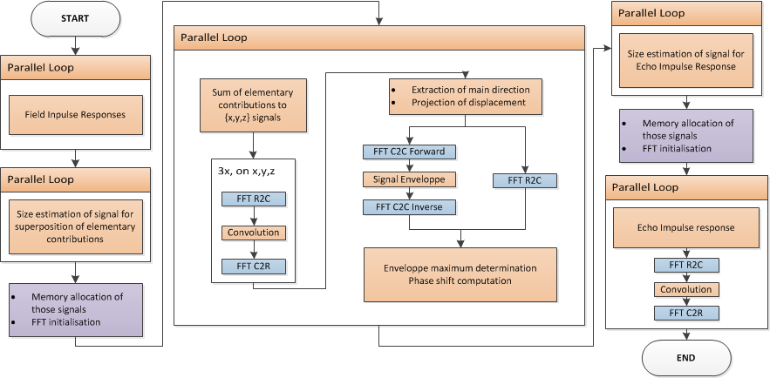
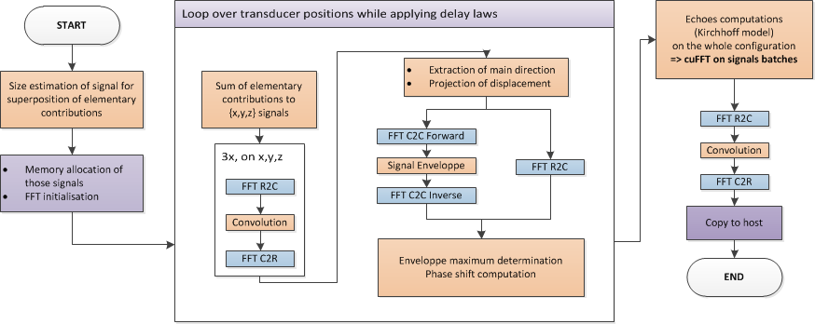
Parallel algorithms overview

Slide 12
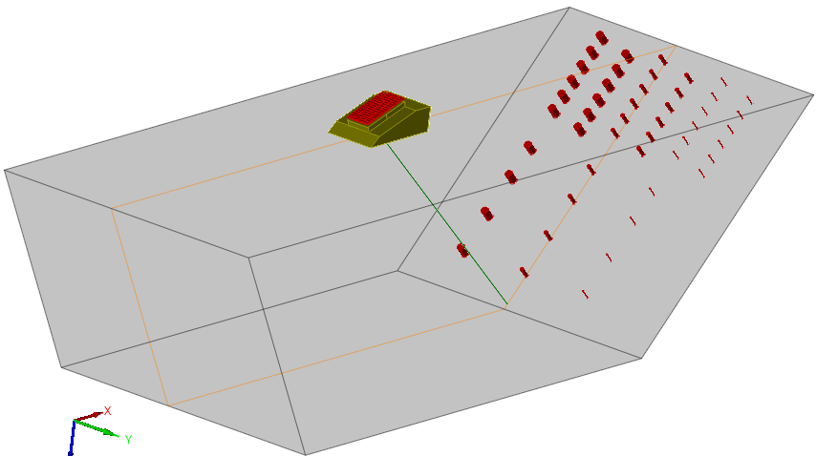
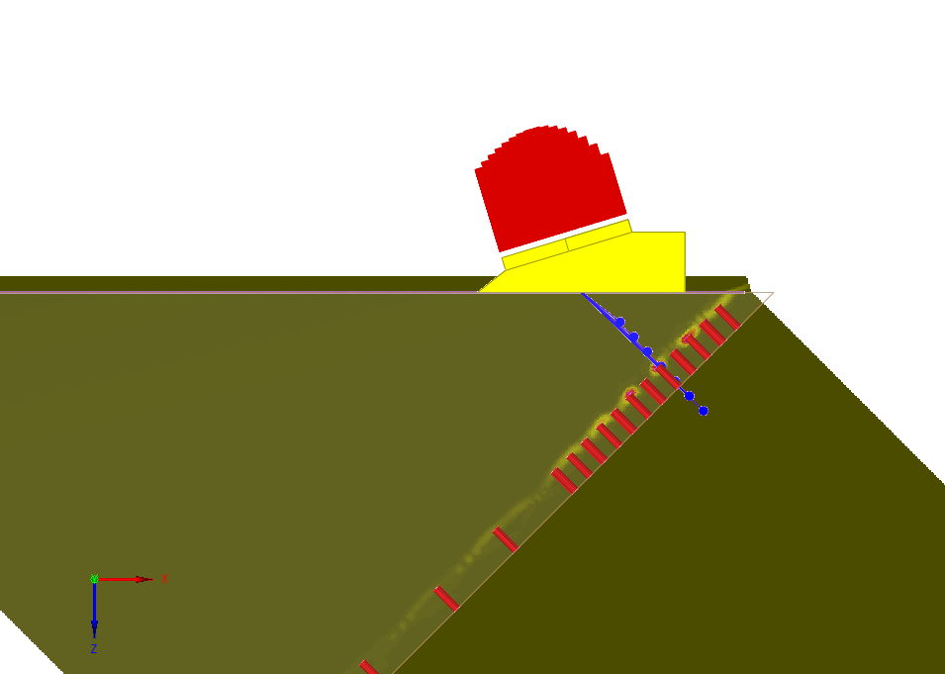
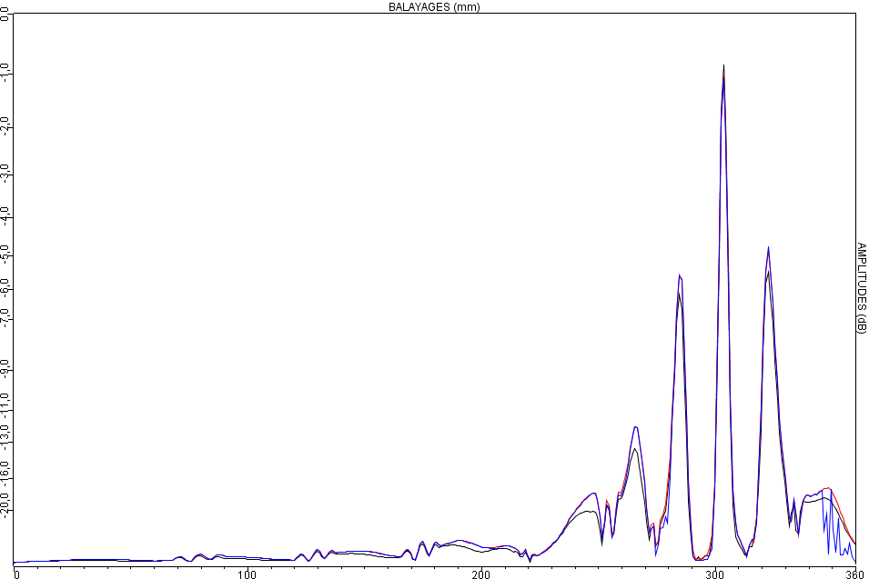
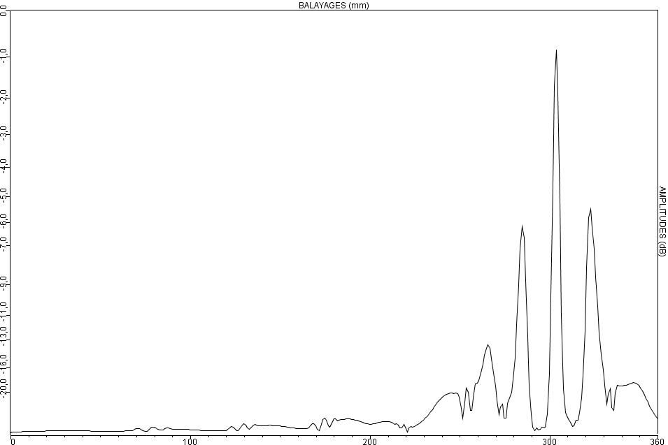
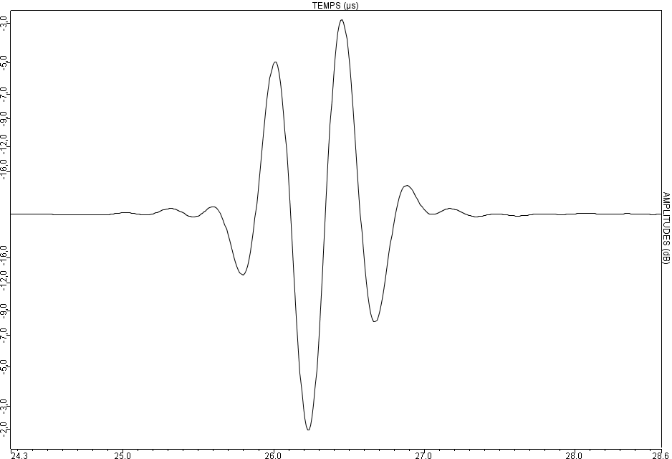
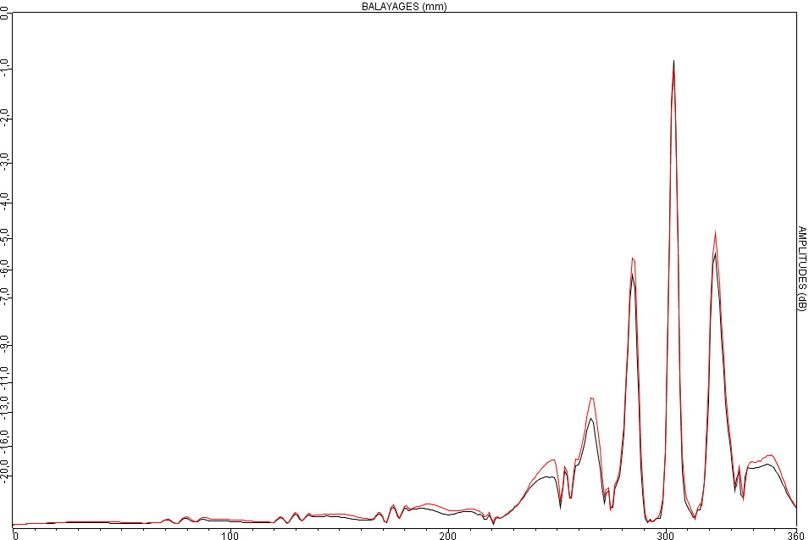
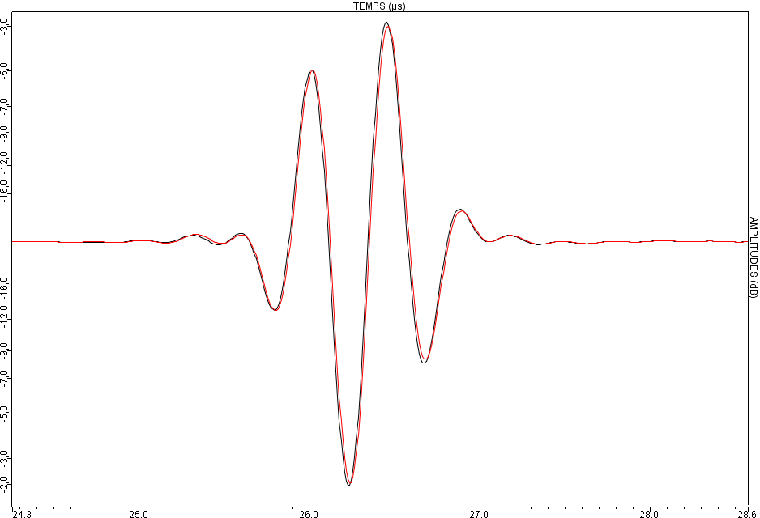
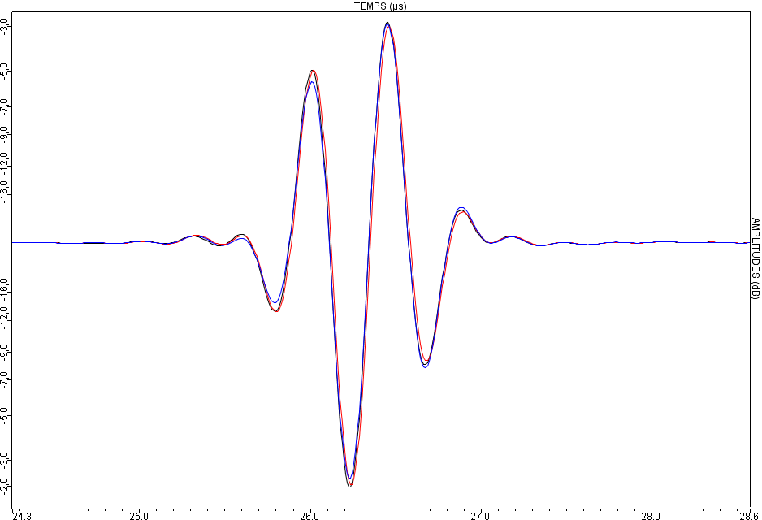
Model validation on QNDE benchmark 2013
Flat bottom holes :
Planar surface, L direct echo, homogeneous isotropic material (steel)
Series1 of 10 Ø3mm FBH
1 out of 7 delay law : delay law L45° + 25mm depth focusing
Reference : CIVA, validated against the benchmark
FBHs
Ø3mm
Serie n°1
Serie n°2
Serie n°1
Serie n°2
Serie n°1
CIVA
0,2dB
Time of flight OK
Front view
Ø3mm FBH
45°
CPU
0,7dB
GPU
0,6dB
Z= 35 25 15 mm

Slide 13
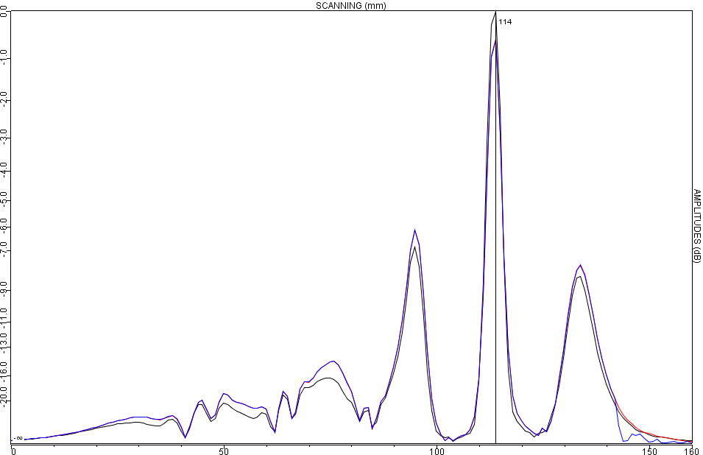
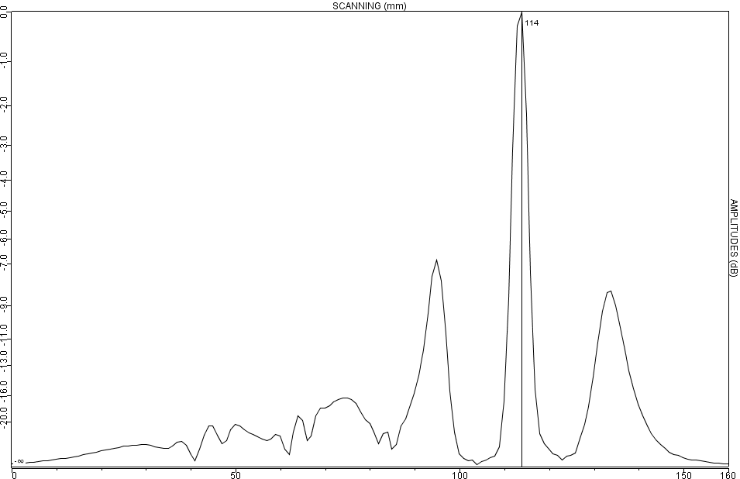
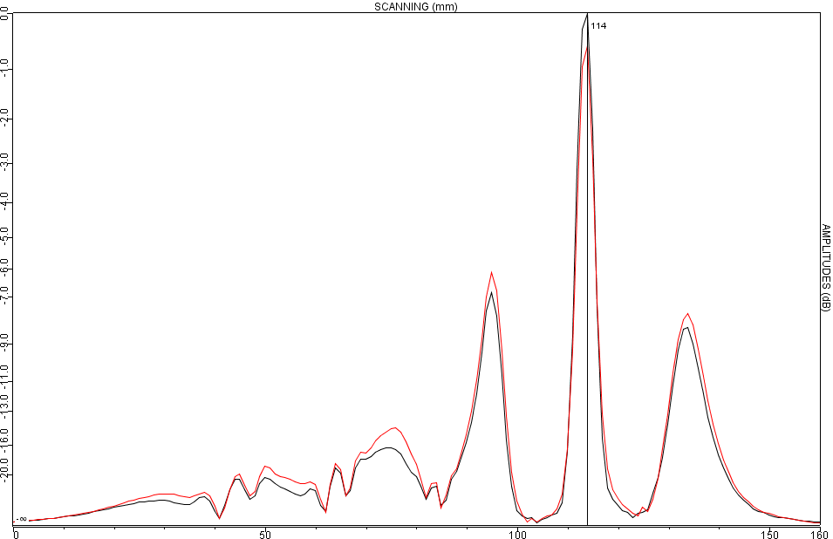
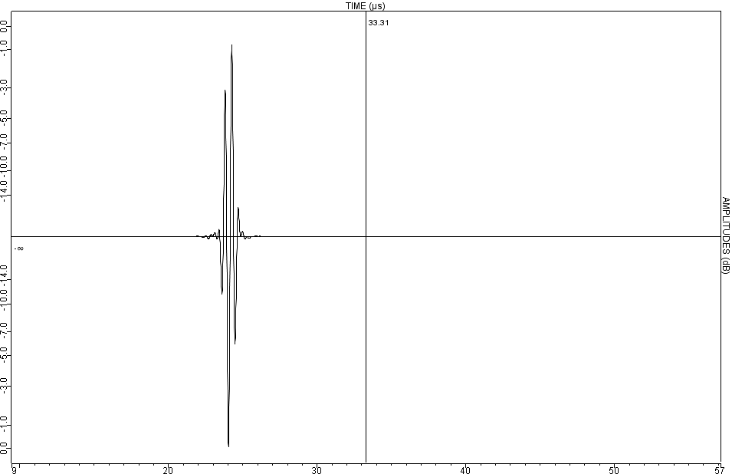
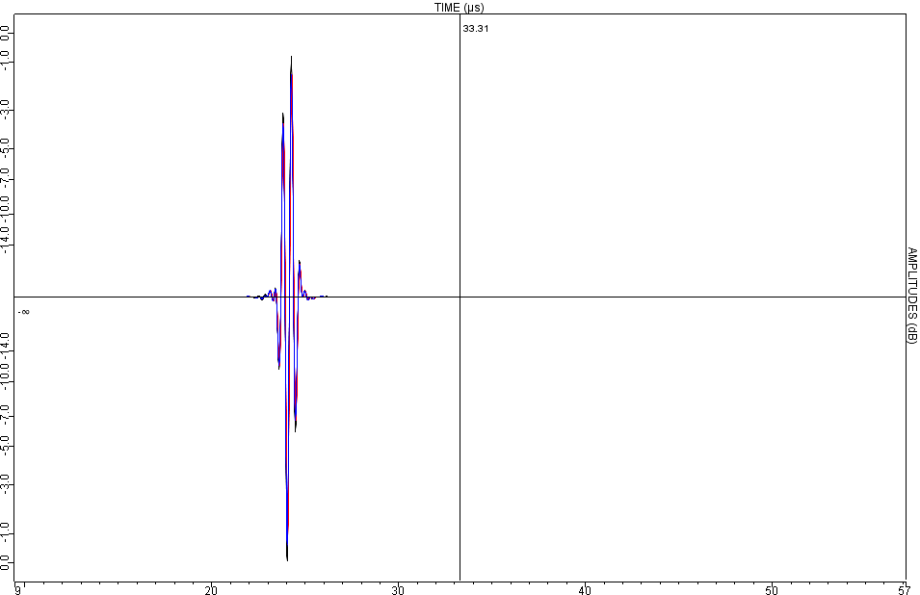
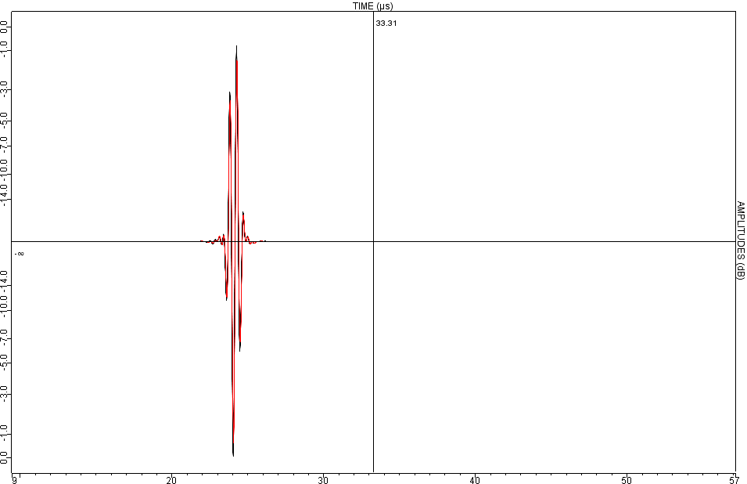
Model validation on QNDE benchmark 2013
Flat bottom holes :
Planar surface, L direct echo, homogeneous isotropic material (steel)
Series2 of 6 Ø3mm FBH
1 out of 7 delay law : delay law L45° + 35mm depth focusing
FBHs
Ø3mm
Serie n°1
Serie n°2
Serie n°1
Serie n°2
Serie n°1
Front view
Ø3mm FBH
45°
0,6dB
CIVA
CPU
GPU
0,8dB
0,6dB
Time of flight OK
Z= 35 25 15 mm

Slide 14
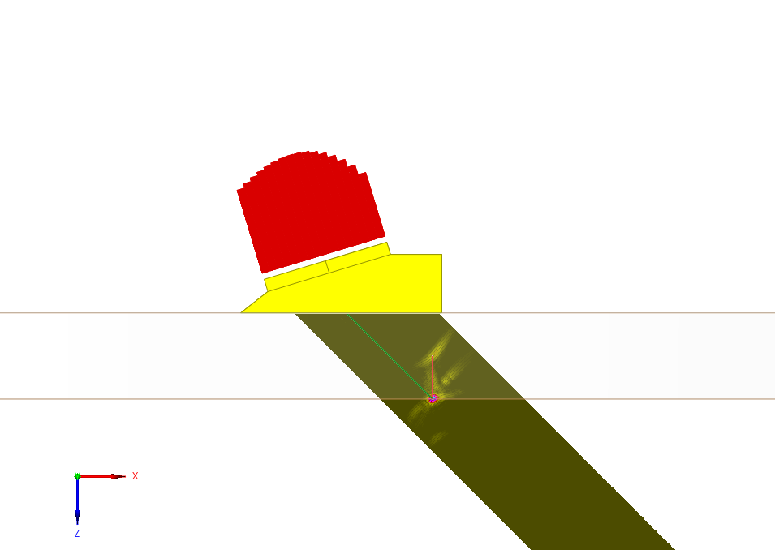
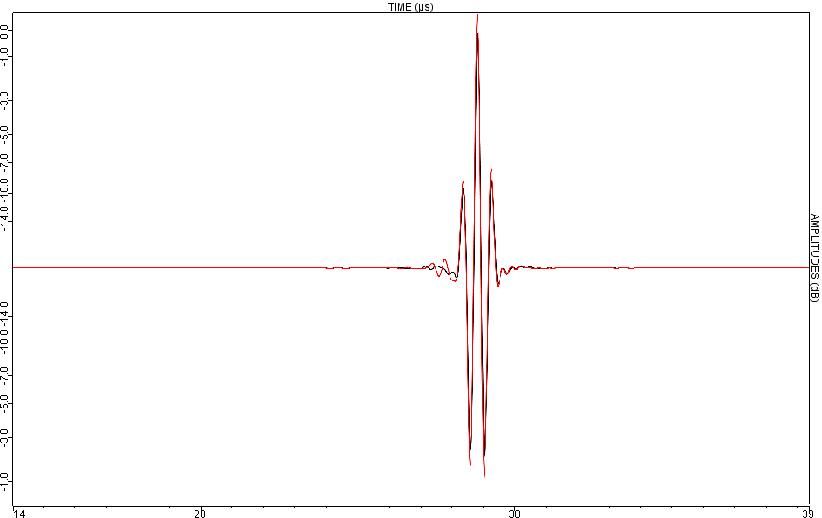
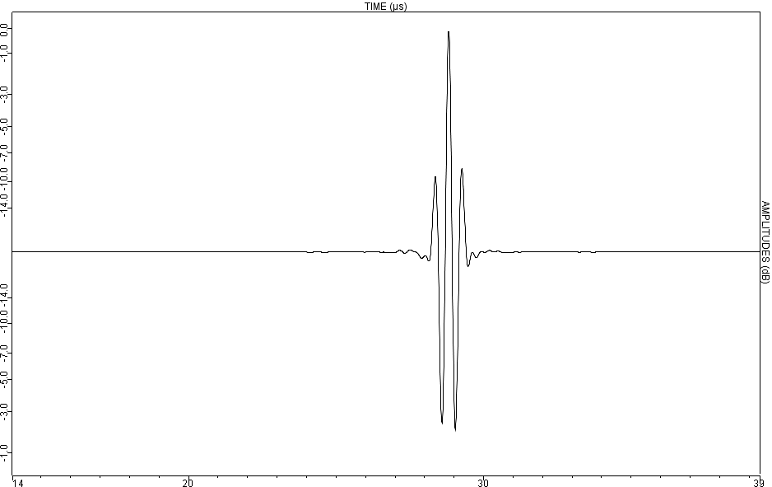
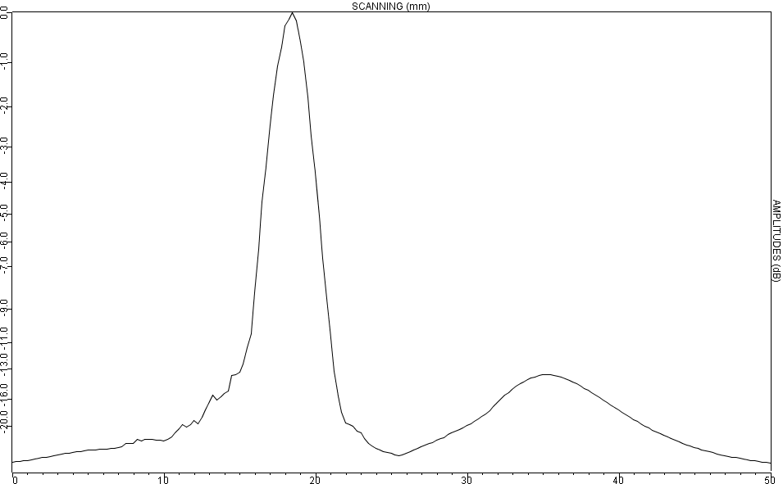
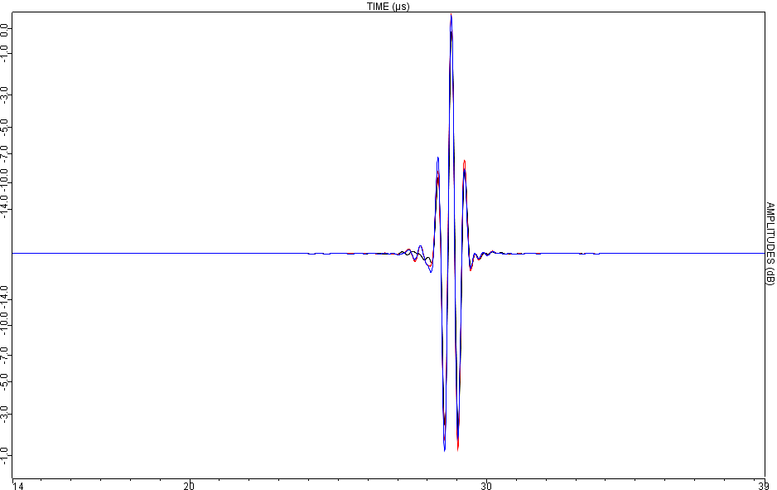
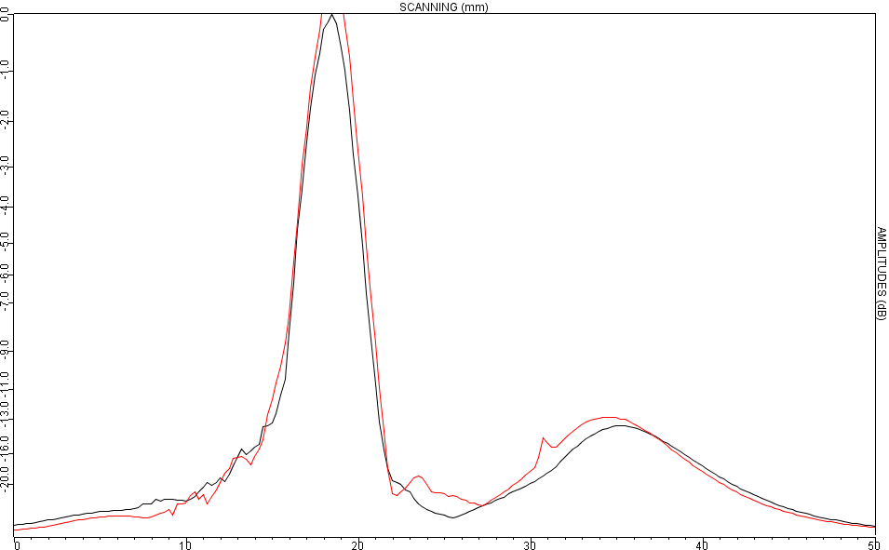
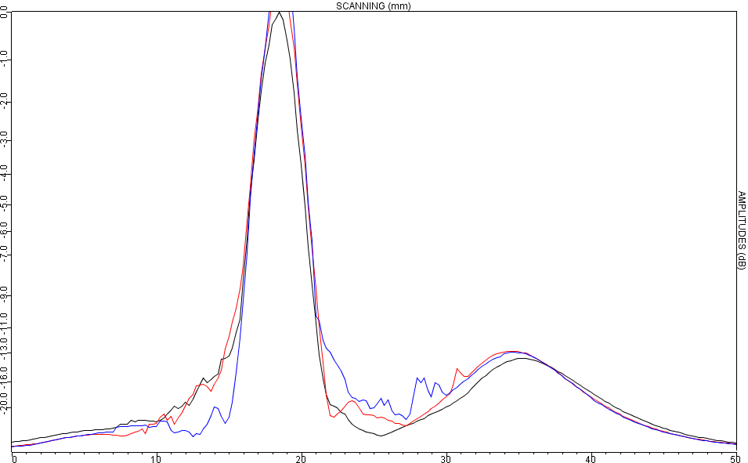
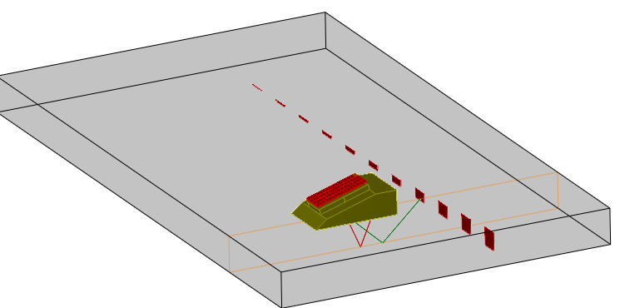
Model validation on QNDE benchmark 2013
Planar defects (backwall breaking notches)
Planar surface, corner echo, homogeneous isotropic material (steel)
Current implementation : L only → only the biggest notch (L mode distinct from others)
1 out of 4 delay law : delay law L45° + 30mm depth focusing
CPU 0.6dB
CIVA
GPU 0.9dB
CPU
GPU
Time of flight OK

Slide 15
Datasets breakdown
,
Dataset | FBH - Series 1 | FBH – Series 2 | Notch
# of defects | 10 FBH | 6 FDH | 1 notch
Probe | 64 channels ↔ 128 samples
# of positions | 361 |  | 201
# delay laws | 7 |  | 4
# UT field sampling | 90 | 54 | 100
# defects sampling | 4140 | 2484 | 12321
Mode | L direct | L direct | Half skip – L

Slide 16
Performances – MULTICORE CPU version
Hardware configuration
2x CPU Intel Xeon 5590 6 cores @3.47Ghz each + Hyperthreading (2x12 logical cores)
24 GB of memory
CPU implementation specificities
Use optimized Intel Math Kernel Library for FFT computations
Each step is parallelized with OpenMP API
Simple precision computations (IEEE 754)
Compiler : Intel® C++ Composer XE 2013 Update 5 Integration for Microsoft Visual Studio 2010, Version 13.0.1211.2010
This machine is also the one running CIVA 11.0

Slide 17
Performances – MULTICORE CPU
Dataset | FBH - Series 1 | FBH – Series 2 | Notch
Fast model on CPU | 7,6 s | 2 s | 7,3 s
CIVA 11.0 | 241 s | 142 s | 363 s
Gain / CIVA 11.0 | x31,7 | x71 | x49,7
Signal processing operations remain the most costly, especially for one echo mode

Slide 18
Performances – GPU
Hardware configuration
NVidia GeForce GTX580 (high end, consumer grade GPU) 512 CUDA cores @1.544Ghz each Fermi architecture
1,5 GB of device memory
GPU implementation specificities
CUDA toolkit version 5.0 on Windows
Simple precision computations (IEEE 754)
Execution time do not include GPU initialization nor the transfer of the result from the device back to the host (at most 200ms on the studied cases)

Slide 19
Performances – GPU
Dataset | FBH - Series 1 | FBH – Series 2 | Notche
GPU version | 5,8 s | 1,7 s | 3,6 s
CPU version | 7,6 s | 2 s | 7,3 s
Gain | X1,3 | X1,17 | x2
Signal processing is costly :
FFT over big memory chunks
Summation require Atomic Operation
Signal processing operations remain the most costly, especially for one echo mode

Slide 20
Conclusions
A fast UT inspection simulation tool has been developed.
Implementation on CPU and GPU validated on QNDE benchmark 2013 (comparison with CIVA)
Acceleration ranging on real data
CPU (12 cores + hyperthreading) : from x31 to x70 over CIVA 11
GPU (512 cores) : from x1.17 to x 2.67 over CPU (12 core + HT) from x41 to x 101 over CIVA 11

Slide 21
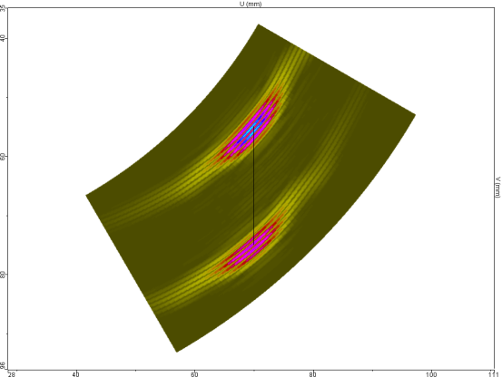
Perspectives
Extension of CPU/GPU implementations :
Another type of defect (e.g. SDH)
Another type of diffraction model (e.g. GTD, SOV)
On the GPU, T mode computation ($ℂ$ computations requiring 2x the memory)
Evolution of the CPU implementation to use SIMD instruction to benefit from short vector operations
Reducing the number of signal processing operations using CIVA model expertise
Integrated within CIVA 12
Interactive simulation is within reach (Sectorial Scan, …)

Slide 22
Thank you for your attention
Sylvain.chatillon@cea.fr
Partially supported by ANR (OPARUS Projet)

